Slide 1
0

Slide 2
Persecution of Hindu Gurus who Help Dalits
Examples of four major gurus under attack:
Kanchi Shankaracharya, promoting Advaita Vedanta
Acharya of the Pejwara Math (Pejawar Swami), promoting Madhva/Dvaita
Chendalangara Mannar Jeer (Sampath Kumara), promoting Ramanuja’s Srivaishnava/Vishistadvaita
Swami Nithyananda, promoting Hindu Aagama for future evolution
1

Slide 3
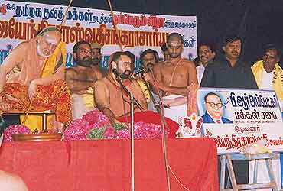
Example 1: Kanchi Shankaracharya’s Dalit outreach
(The Pioneer 19th November 2002) Dalits: Kanchi leads the way By Sandhya Jain The Shankaracharya of Kanchi, Swami Jayendra Saraswati, broke a critical stalemate in the current controversy over the merits of the Tamil Nadu ban on conversions by force, fraud or inducement, by offering worship at a Dalit-run temple in Madurai (The Hindu, 12 Nov. 2002). The Veerakali Amman temple, which serves the religious needs of eighteen villages and has a Dalit priest, lies in the Melur region where 250 Hindus were converted en masse by a Canadian priest of the Seventh Day Adventists on 25 August 2002. Previously, about fifteen hundred Hindus were converted in the neighbouring areas in January 2001. By giving the villagers an unexpected darshan, the Shankaracharya gracefully shattered several myths and assumptions about inequality and divisiveness in Hindu society.
Source - http://www.sandhyajainarchive.org/2002/11/19/dalits-kanchi-leads-the-way/
At the launch of Ambedkar Makkal Sabhai' (Ambedkar People's Forum), formed by 20-odd Dalit leaders in 2004
Source - http://www.outlookindia.com/website/story/slumming-it-out/223004
2

Slide 4
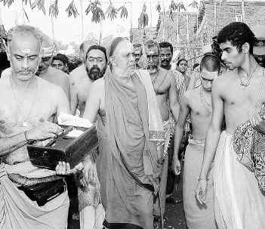
Kanchi Mutt has organized medical assistance to the residents of this neighbourhood
Visit to Dalit run Muthappaswamy Karungaliamman temple, Annai Sathya Nagar at Vyasarpadi
3

Slide 5
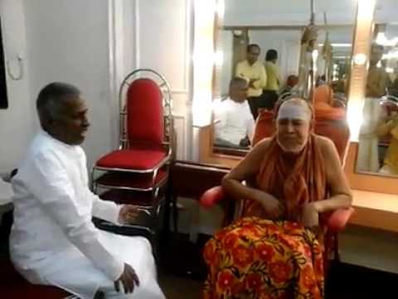
Music composer Ilayaraja, of Dalit Christian heritage, performing for the Shankaracharya
4

Slide 6
Persecution of Kanchi Shankaracharya
13 DECEMBER 2004 | NATIONAL |SHANKARACHARYA
How The Gods Fall
Cold-blooded murders, allegations of child abuse, sexual harassment. The killing of Sankararaman is one, the closets of the Kanchi math seem to be full of gory stuff. Updates
S. ANAND
13 DECEMBER 2004 | NATIONAL
'If You Cooperate, I Can Extend You All Benefits’
This is what the seer told this Tamil writer. Her account of what happened.
ANURADHA RAMAN
Source - https://www.outlookindia.com/magazine/story/if-you-cooperate-i-can-extend-you-all-benefits/225947
Source Outlook Dec 13, 2004 (allegations of murder and sexual harassment – none proved in court) - https://www.outlookindia.com/magazine/story/how-the-gods-fall/225945
5

Slide 7
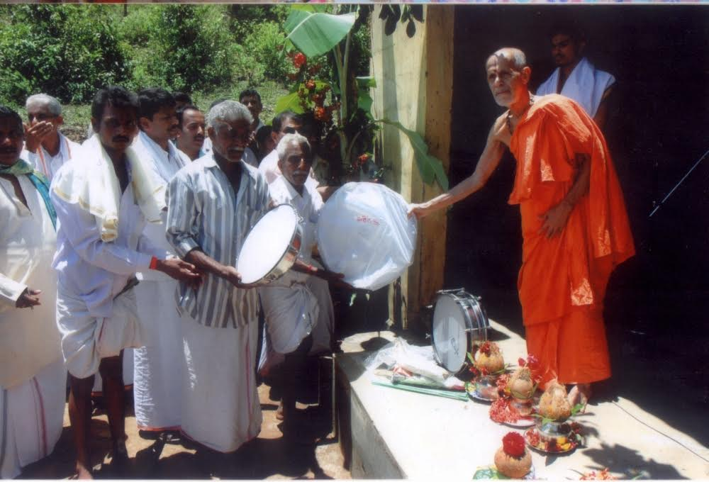
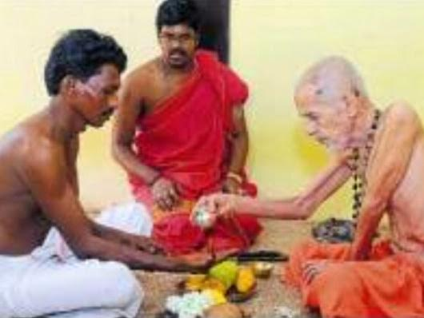
Example 2: The Pejavara Swami with his Dalit Devotees
Swami conducting a puja for traditional drums and for the welfare of the artistes
A Vaishnava Diskha - initiation ceremony - to help people in their spiritual journey
6

Slide 8
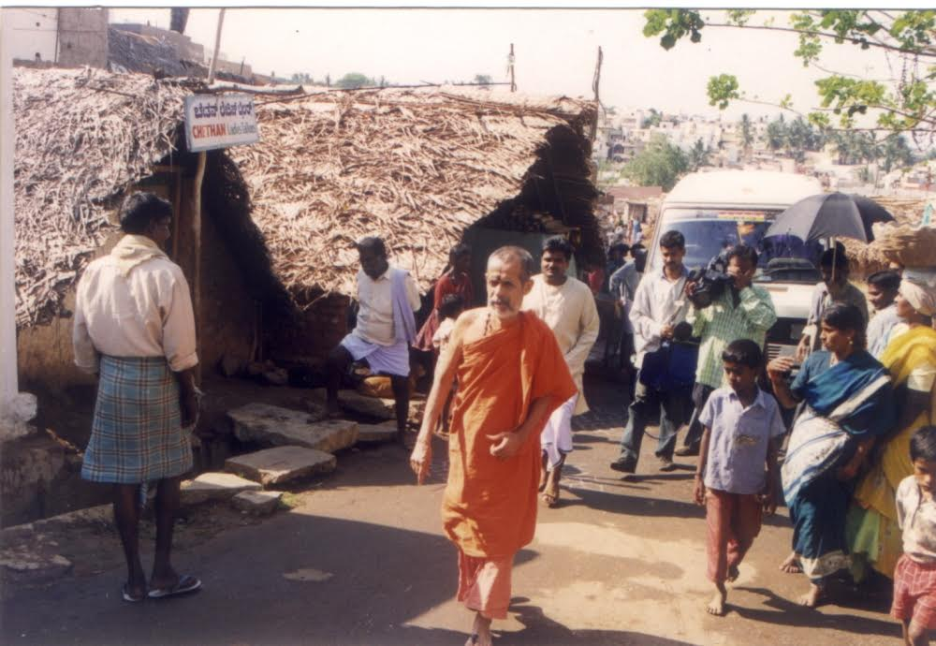
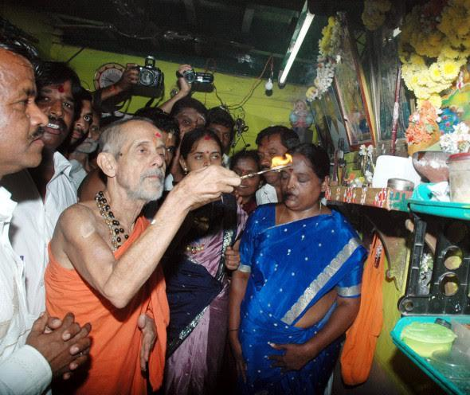
The Pejavara Swami with his Dalit Devotees
Visiting hamlets and blessing devotees
Conducting puja and blessing Dalit homes
7

Slide 9
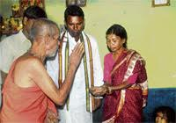
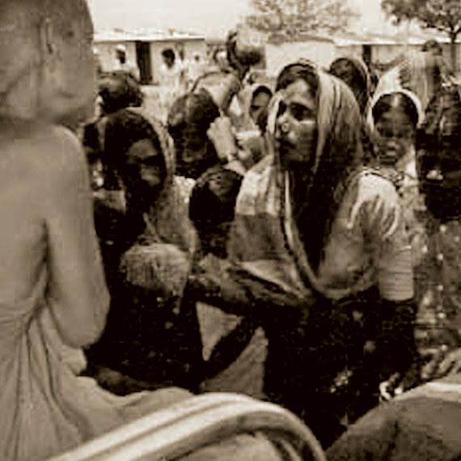
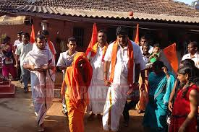
The Pejavara Swami with his Dalit Devotees
Blessing, listening to people’s concerns across India
8

Slide 10
Chalo Udupi - a Reaction Against Pejavara Swami’s success with Dalits
False accusation of discrimination against Dalits in matha
Jignesh Mewani and H Prasad, the faces of this agitation, have contacts with Breaking India forces
Jignesh Mewani – connected to Martin Macwan
H Prasad – supported by Indian Writers Forum which includes Lawrence Liang, a Soros guy
9

Slide 11
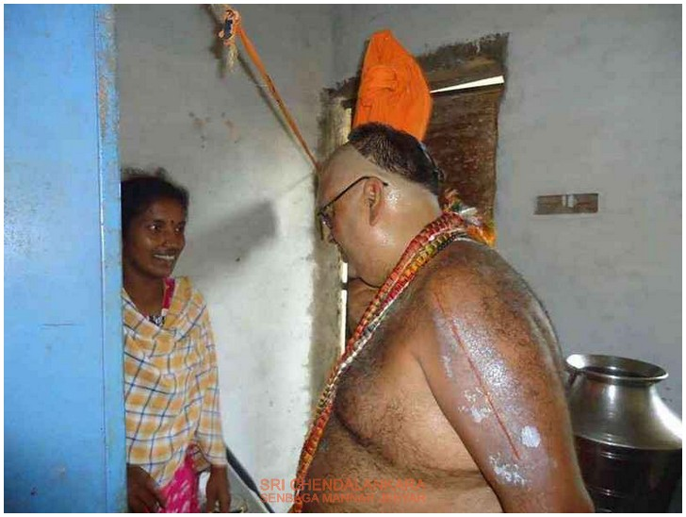
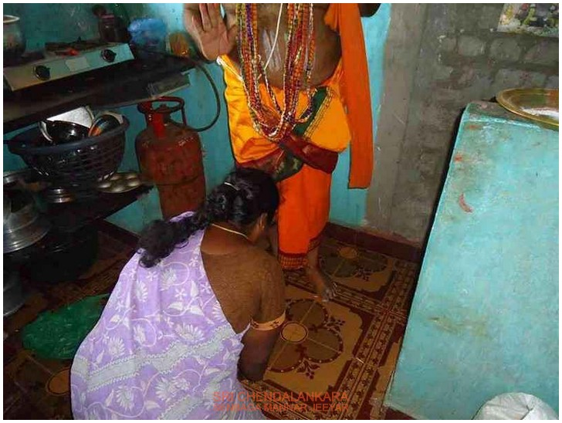
Example 3: Sri Sri Chendalangara Shenbagamannar Sampath Kumara Ramanuja Jeer
Jeer Swami’s outreach (visiting Dalit homes)
10

Slide 12
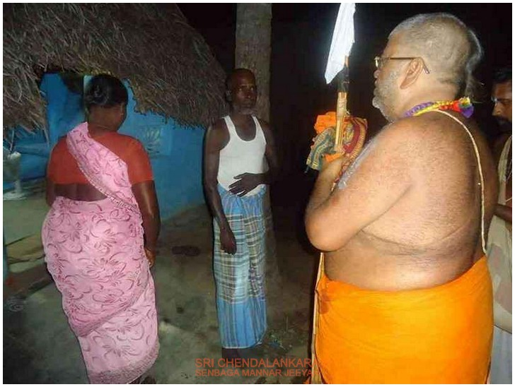
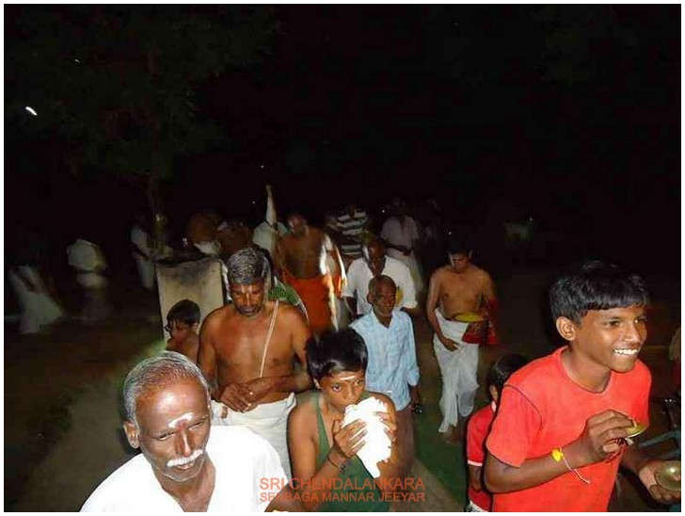
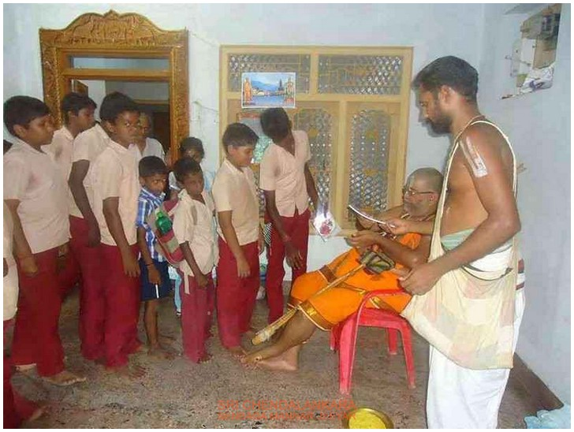
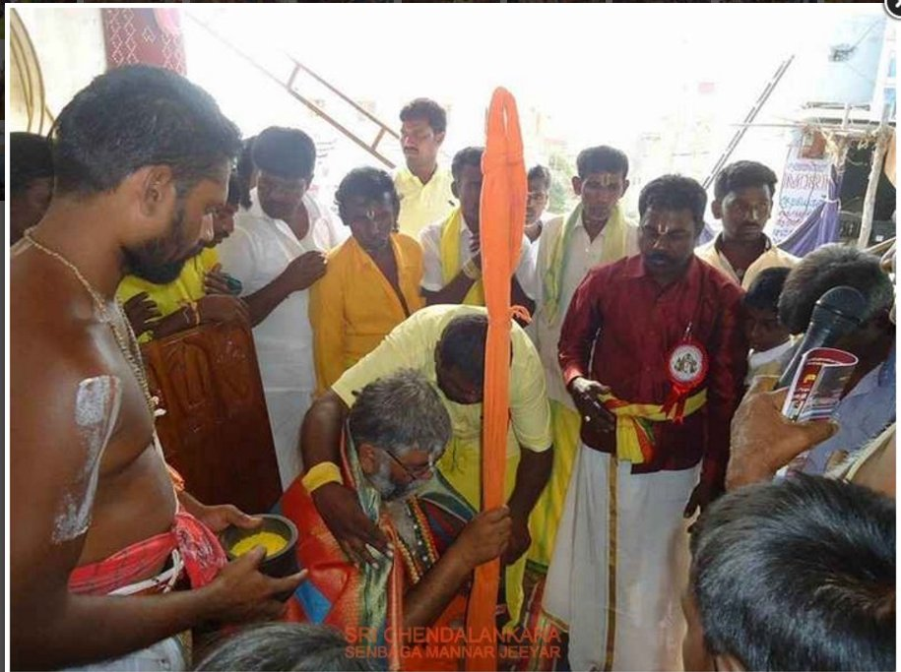
11

Slide 13
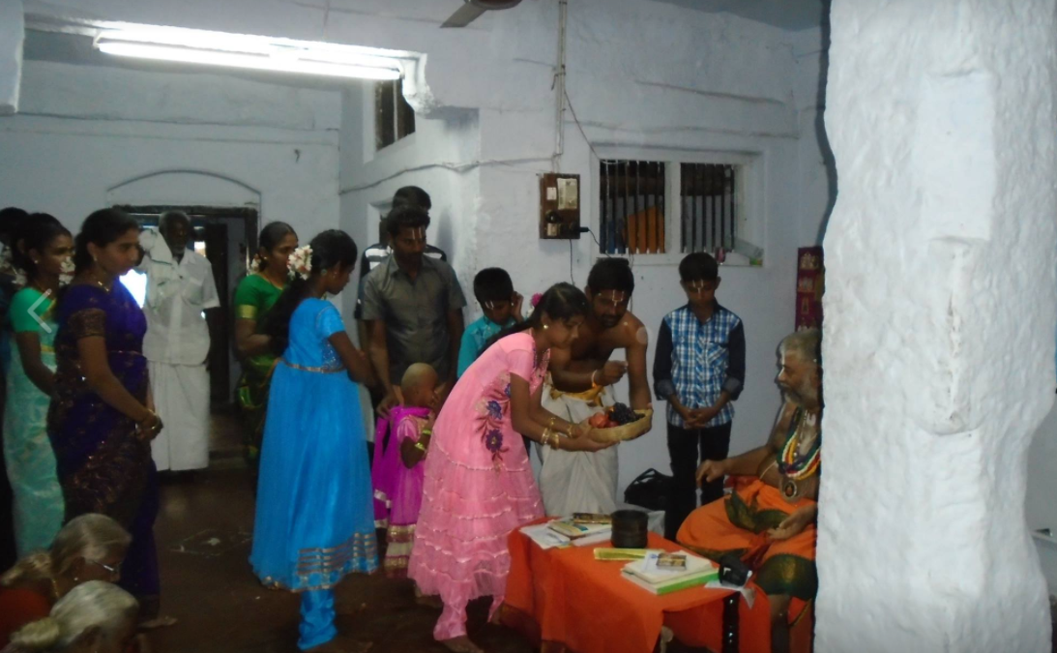
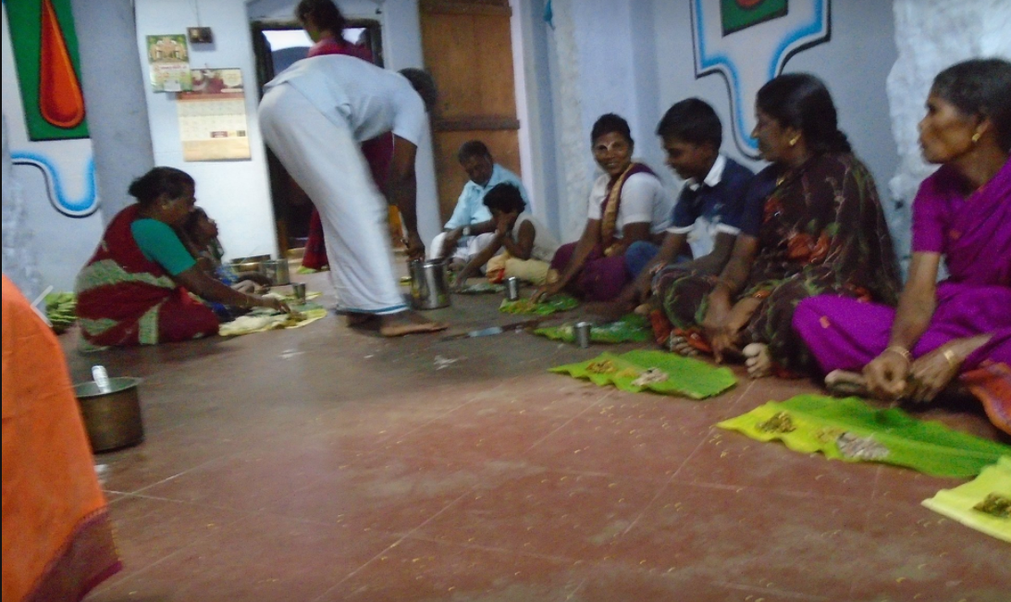
Devotees of all castes paying respects to the seer and having prasadam in the Mutt’s premises
12

Slide 14
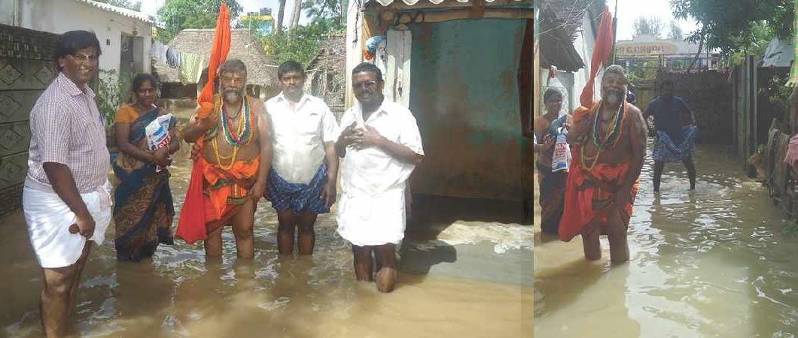
Providing Direct Assistance to Dalit Colonies During 2015 Floods
13

Slide 15
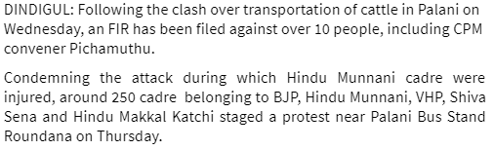
Persecution by Creating Artificial Controversy
Swamiji and Hindu activists attacked by VCK, SDPI, CPM and Islamist extremists near Palani
Frontline spun the story as though Swamiji indulged in violence (Frontline July 21, 2017)
The New Indian Express (30th June, 2017)
14

Slide 16
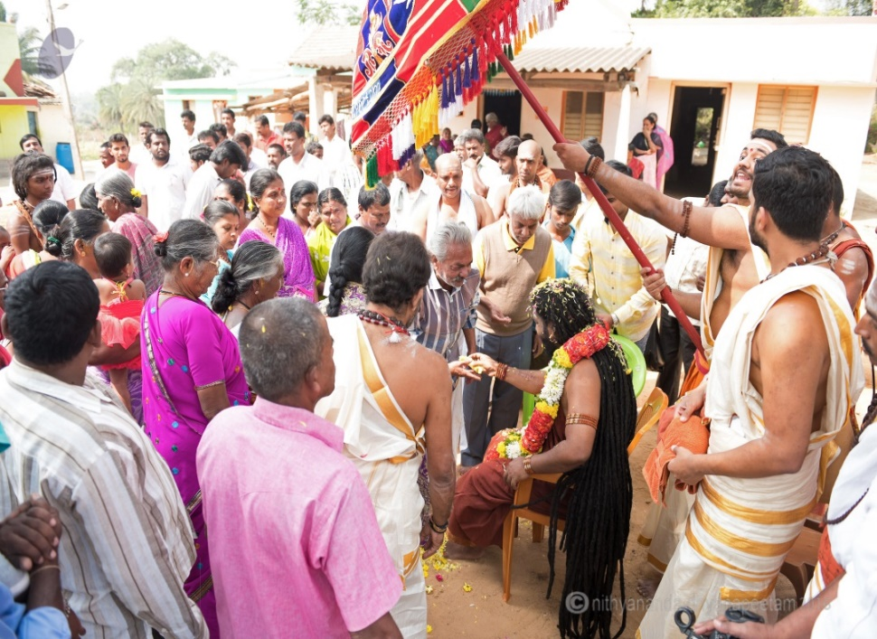
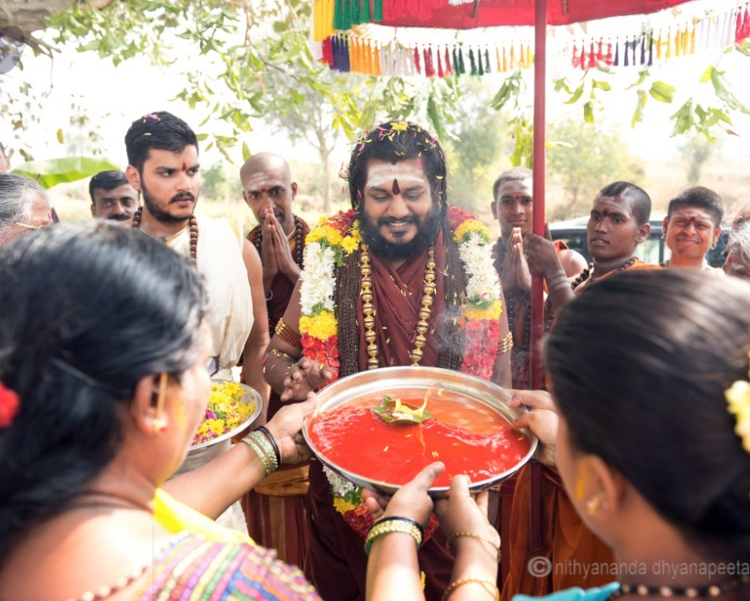
Swami Nithyananda
Swamiji blessing various sections of people
15

Slide 17
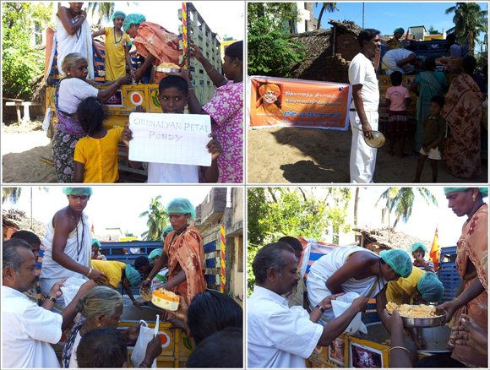
Swami Nithyananda’s Social Work
Relief works during natural calamities
16

Slide 18
Fake Video Used Against Swami Nithyananda
https://youtu.be/YdLDypTvbBk#t=0m38s
COO of Sun TV, Mr Saxena confesses that fake video was used to make false allegations of sexual misconduct against Swami Nithyananda for extortion
High Courts of Madras and Karnataka have quashed proceeding against Swamiji and given judgments in his favor respectively
17

